Slide 1

Global Architect Summit
Session 04
Design Your Azure Application

Slide 2
Objectives
Design for Scalability
Design for High Availability
Design for Resilience
Design for Data
Design for Messaging
Design for Management and Monitoring
Case Studies

Slide 3

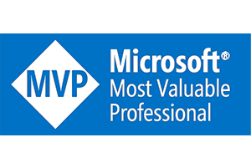

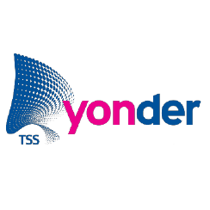

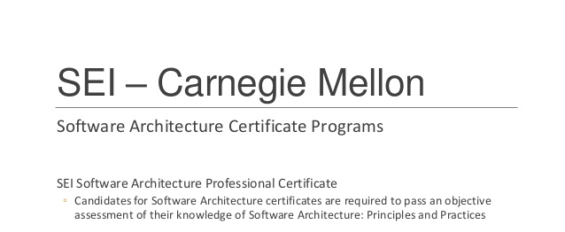

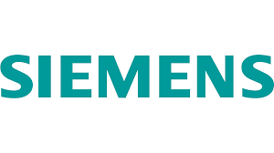
About Your Speaker
This session is being delivered by Silviu Niculiță, an effective technology professional with decades of experience in implementing high-availability/high-capacity software products.
Professional Experience Qualifications

Slide 4
Pillars of a Well Designed Application
Scalability, availability, resiliency, management, and security are the five pillars of quality software.
Focusing on these pillars will help you design a successful cloud application.
Scalability
Availability
Resiliency
Management
Security
Notes:
Scalability Design the system to be able scale out by adding new instances.
Availability Define a service level objective (SLO) that clearly defines the expected availability, and how it is measured. Use the critical path to define. An extra percentage point of availability can add up to additional hours or days of uptime over a year.
Resiliency Cloud applications have occasional failures and must be built to recover from them. Build resiliency mitigations into your application at all levels. Focus on tactical mitigations first, and include monitoring.
Management Automate deployments and make them a fast and routine process to speed the release of new features or bug fixes. Build in roll back or roll forward operations, and include monitoring and diagnostics.
Security Build identity management, infrastructure protection, and data sovereignty and encryption into your application and into your DevOps processes.

Slide 5
Design for Scalability

Slide 6
Scalability
Vertical scaling (scaling up) means increasing the capacity of a resource, for example by using a larger VM size.
Horizontal scaling (scaling out) is adding new instances of a resource, such as VMs or database replicas.
Notes:
Scalability is the ability of a system to handle increased load. There are two main ways that an application can scale.

Slide 7
Horizontal Scaling
True cloud scale. Applications can be designed to run on hundreds or even thousands of nodes, reaching scales that are not possible on a single node.
Horizontal scale is elastic. You can add more instances if load increases, or remove them during quieter periods.
Scaling out can be triggered automatically, either on a schedule or in response to changes in load.
Notes:
Horizontal scaling has significant advantages over vertical scaling:

Slide 8
Horizontal Scaling
Scaling out may be cheaper than scaling up. Running several small VMs can cost less than a single large VM.
Horizontal scaling can also improve resiliency, by adding redundancy. If an instance goes down, the application keeps running.
Notes:
Horizontal scaling has significant advantages over vertical scaling:

Slide 9
Horizontal Scaling
Scaling out may be cheaper than scaling up. Running several small VMs can cost less than a single large VM.
Horizontal scaling can also improve resiliency, by adding redundancy. If an instance goes down, the application keeps running.
Notes:
Horizontal scaling has significant advantages over vertical scaling:
Horizontal scale must be designed into the system. For example, you can scale out VMs by placing them behind a load balancer. But each VM in the pool must be able to handle any client request, so the application must be stateless or store state externally (say, in a distributed cache). Managed PaaS services often have horizontal scaling and auto-scaling built in.

Slide 10
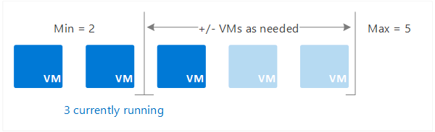

Horizontal Scaling
Notes:
Autoscaling enables you to run the right amount of resources to handle the load of your app. It adds resources (called scaling out) to handle an increase in load such as seasonal workloads. Autoscaling saves money by removing idle resources (called scaling in) during a decrease in load such as nights and weekends for some corporate apps.
You automatically scale between the minimum and maximum number of instances to run and add or remove VMs automatically based on a set of rules.

Slide 11
Vertical Scaling
An advantage of vertical scaling is that you can do it without making any changes to the application.
But at some point you will hit a limit, where you can’t scale up any longer.
Notes:
At that point, any further scaling must be horizontal.
However, just adding more instances doesn’t mean an application will scale. It might simply push the bottleneck somewhere else. For example, if you scale a web front-end to handle more client requests, that might trigger lock contentions in the database. You would then need to consider additional measures, such as optimistic concurrency or data partitioning, to enable more throughput to the
database.
Always conduct performance and load testing to find these potential bottlenecks. The stateful parts of a system, such as databases, are the most common cause of bottlenecks, and require careful design to scale horizontally. Resolving one bottleneck may reveal other bottlenecks elsewhere.

Slide 12
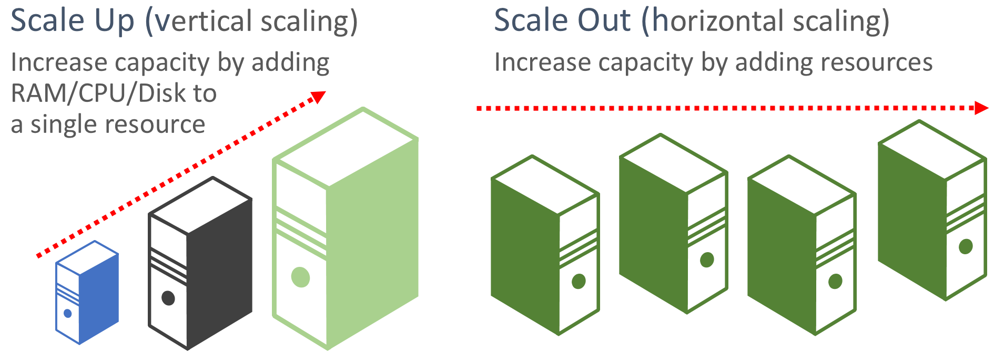
Vertical Scaling
Notes:
Vertical scaling means adding more power to your web app / VM. You’ll still have a single instance and you’re upping the specs of it. It’s great because, while you are solving for performance, you’re saving costs too as you’re only paying a minimal amount, only having to pay extra when your web app scales up. However, one obvious limit is “availability” – when the datacenter that hosts your web app goes down, your website goes down with it.
Horizontal scaling on the other hand adds more machines to your pool of resources. Setting this up is a little bit more complicated as you’ll need a load balancer on top and most likely a service bus too to ensure all resources are in sync. However, not only will you be solving for performance but for availability as well. So if you’re website requires High Availability (HA), then you probably will want to consider a failover region, setting up a resource that’s hosted in a different region.

Slide 13
Design for High Availability

Slide 14
High Availability
Availability is the proportion of time that the system is functional and working.
It is usually measured as a percentage of uptime. Application errors, infrastructure problems, and system load can all reduce availability.

Slide 15

HA Multi-Region Web Application
Notes:
This reference architecture shows how to run an Azure App Service application in multiple regions to achieve high availability.
Primary and secondary regions. This architecture uses two regions to achieve higher availability. The application is deployed to each region. During normal operations, network traffic is routed to the primary region. If the primary region becomes unavailable, traffic is routed to the secondary region.
Front Door. Front Door routes incoming requests to the primary region. If the application running that region becomes unavailable, Front Door fails over to the secondary region.
Geo-replication of SQL Database and/or Cosmos DB.

Slide 16
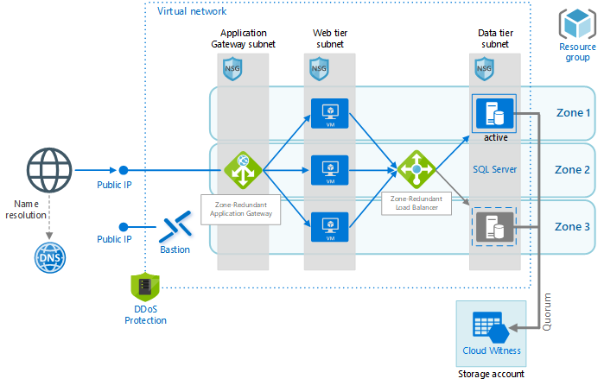
HA for Web Application with Relational Database
Notes:
The architecture uses resources spread across multiple zones to provide a high availability (HA) architecture for hosting an Infrastructure as a Service (IaaS) web application and SQL Server database. A zone-redundant application gateway routes traffic to virtual machines within the web tier. A zone-redundant load balancer routes traffic from the virtual machines in the web tier to the active SQL Server. In the case of a zonal failure, the application gateway will route to virtual machines in the other available zones.
If the active SQL Server becomes unavailable, either due to a zone failure or local failure, a passive SQL Server will become the active SQL Server. The zone-redundant load balancer will detect the failover of SQL Server and route traffic to the newly active SQL Server.

Slide 17
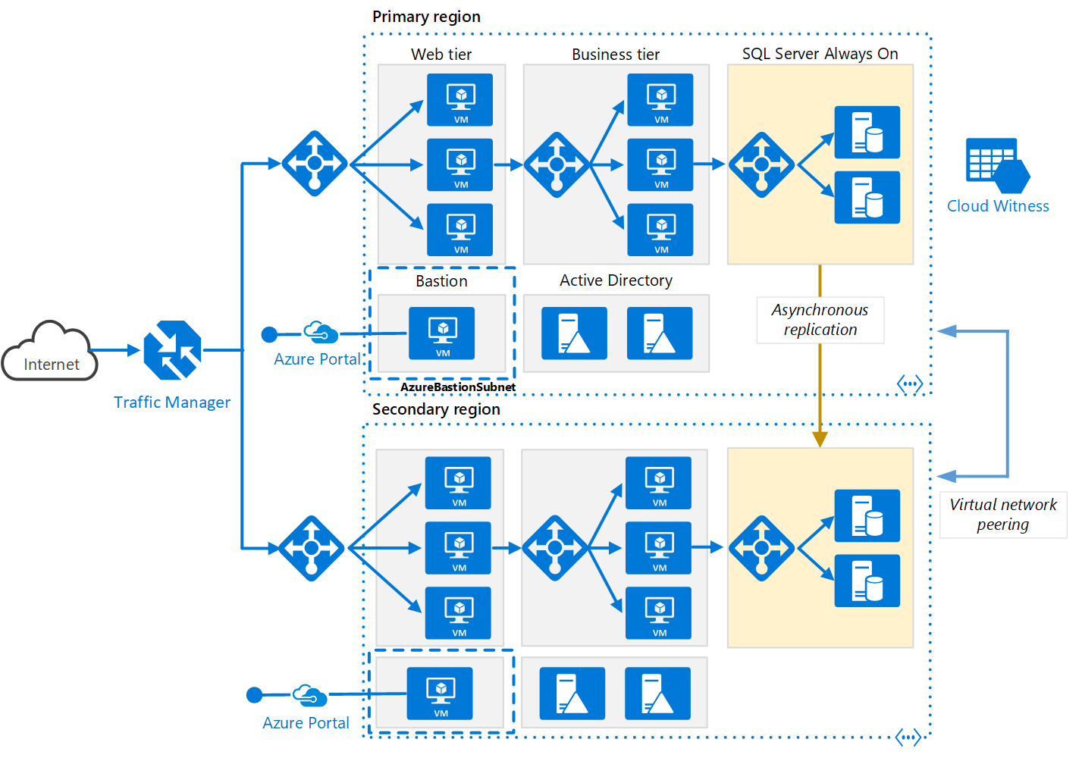
HA for Multi-Region N-tier application
Notes:
This reference architecture shows a set of proven practices for running an N-tier application in multiple Azure regions, in order to achieve availability and a robust disaster recovery infrastructure.
Primary and secondary regions. Use two regions to achieve higher availability. One is the primary region. The other region is for failover.
Azure Traffic Manager. Traffic Manager routes incoming requests to one of the regions. During normal operations, it routes requests to the primary region. If that region becomes unavailable, Traffic Manager fails over to the secondary region. For more information, see the section Traffic Manager configuration.
Resource groups. Create separate resource groups for the primary region, the secondary region, and for Traffic Manager. This gives you the flexibility to manage each region as a single collection of resources. For example, you could redeploy one region, without taking down the other one. Link the resource groups, so that you can run a query to list all the resources for the application.
Virtual networks. Create a separate virtual network for each region. Make sure the address spaces do not overlap.
SQL Server Always On Availability Group. If you are using SQL Server, we recommend SQL Always On Availability Groups for high availability. Create a single availability group that includes the SQL Server instances in both regions.

Slide 18
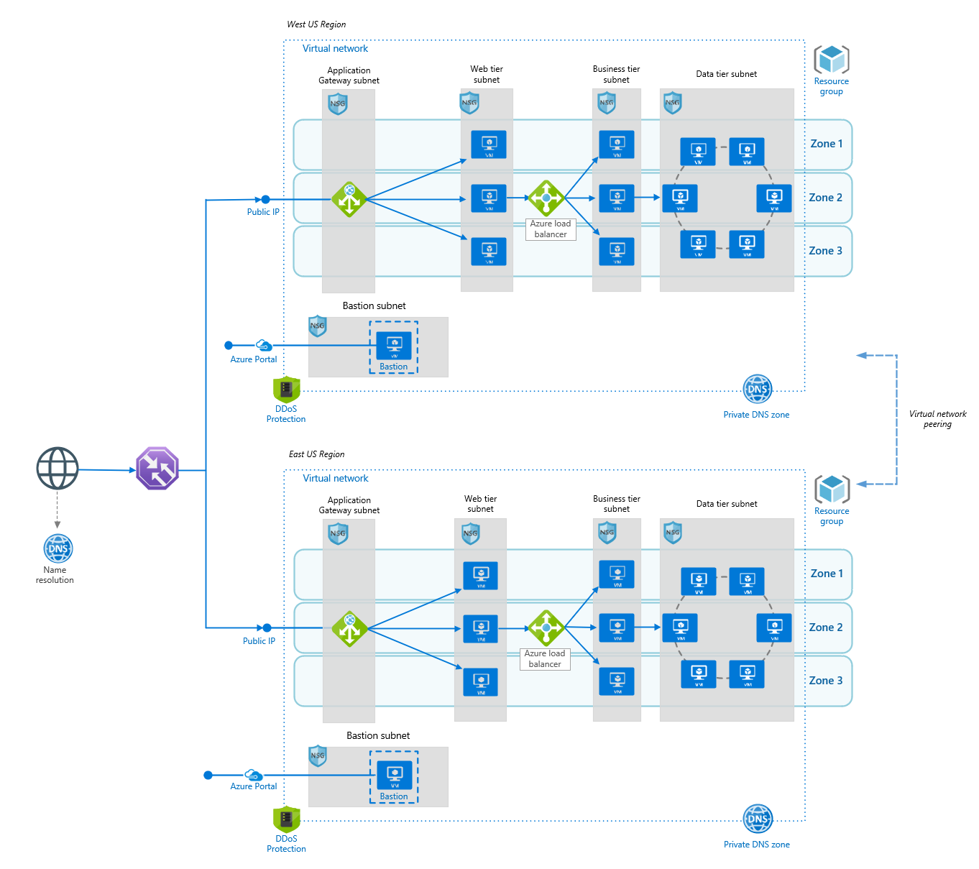
High Availability in Multi-Region Load Balancing
Notes:
This reference architecture is applicable to any industry that intends to serve web workloads and needs to deploy resilient multitier applications in multiple Azure regions, in order to achieve availability and a robust disaster recovery infrastructure. In this reference architecture, Azure Traffic Manager performs the global load balancing of web traffic across Azure regions, which have a regional load balancer based on Azure Application Gateway. This combination gets you the benefits of Traffic Manager many routing rules and Application Gateway’s capabilities such as WAF, TLS termination, path-based routing, cookie-based session affinity among others. In this scenario, the application consists of three layers.

Slide 19
Design for Resilience

Slide 20
Resiliency
Resiliency is the ability of the system to recover from failures and continue to function.
The goal of resiliency is to return the application to a fully functioning state after a failure occurs. Resiliency is closely related to availability.
Notes:
In traditional application development, there has been a focus on reducing mean time between failures (MTBF). Effort was spent trying to prevent the system from failing. In cloud computing, a different mindset is required, due to several factors: Distributed systems are complex, and a failure at one point can potentially cascade throughout the system. Costs for cloud environments are kept low through the use of commodity hardware, so occasional hardware failures must be expected. Applications often depend on external services, which may become temporarily unavailable or throttle high-volume users. Today’s users expect an application to be available 24/7 without ever going offline.

Slide 21
Built-in Azure Resilience Services
Notes:
Despite all the investments Microsoft puts into making the platform reliable, apps can suffer from downtime because of unplanned events such as power failures, data corruption, ransomware attacks, as well as fires or natural disasters. The graphic below illustrates key Azure service offerings for various types of failures that can occur

Slide 22
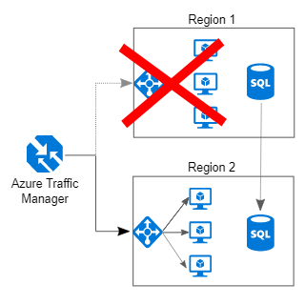
Resiliency
Notes:
Despite all the investments Microsoft puts into making the platform reliable, apps can suffer from downtime because of unplanned events such as power failures, data corruption, ransomware attacks, as well as fires or natural disasters. The graphic below illustrates key Azure service offerings for various types of failures that can occur

Slide 23
Typical Resilience Pattern for A 3 Tier Application
Notes:
Hardware failure
Build redundancy by deploying two or more instances in an Availability Set within a datacenter.
Datacenter failure
Operate ready-to-use templates to deploy another instance using backup copies (if required) in another availability zone. Test templates by deploying VMs into a test subnet or a test virtual network in another zone.
Regional failure
Use Azure Site Recovery to replicate the database VM. Test the disaster recovery using test failover and Azure Site Recovery plans. Perform a disaster recovery failover in the event of an extended outage in the source region.
Heavy load
Use monitoring tools to identify load surges on the VM. Increase the size of the VM or scale up by adding more instances.
Accidental data deletion or corruption
Use Azure Backup to back up VMs. Test data recovery by restoring files, disks, VMs, or SQL databases. Restore data if an accidental deletion occurs.
Application deployment failure
Use automation scripts to deploy updates. If an issue is observed during the update process or after the update, roll back to the previous version with an automated script.

Slide 24
Typical Resilience Pattern
Notes:
Hardware failure
Build redundancy by deploying two or more VM instances across availability zones within a region.
Datacenter failure
Build redundancy by deploying two or more VM instances across availability zones within a region.
Regional failure
Use Azure Site Recovery to replicate all VMs in the web tier and middle tier. Use global data distribution with Cosmos DB. Test the disaster recovery of the complete application (including Cosmos DB failover). Perform disaster recovery failover in the event of an extended outage in a source region.
Heavy load
Provision enough capacity into the application. Use tools to monitor the load and add more instances that automatically use scripts if the threshold (for example, 70 percent) is reached.
Accidental data deletion or corruption
Use Azure Backup to back up all VMs and SQL databases. Test data recovery by restoring files, disks, VMs or SQL databases. Restore the data if an accidental deletion occurs.
Application deployment failure
Use safe deployment practices to roll out the updates to a minimal set of customers before deploying it widely. Use automation scripts to deploy updates with the automatic roll back capability built in if there’s an issue with the update deployment. Have alerts configured to send alarms if an issue occurs after an update deployment. If any occur, have the automated roll back script ready to execute.

Slide 25
Design for Data

Slide 26
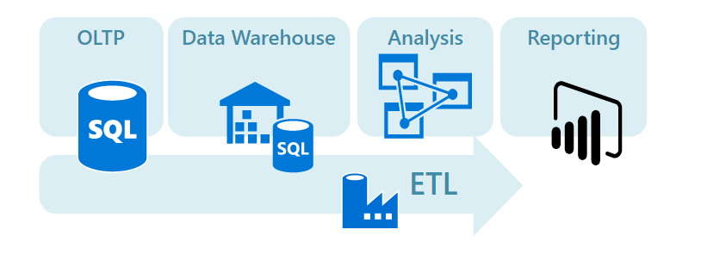
Traditional RDBMS Workloads
Notes:
These workloads include online transaction processing (OLTP) and online analytical processing (OLAP). Data in OLTP systems is typically relational data with a predefined schema and a set of constraints to maintain referential integrity. Often, data from multiple sources in the organization may be consolidated into a data warehouse, using an ETL process to move and transform the source data.

Slide 27
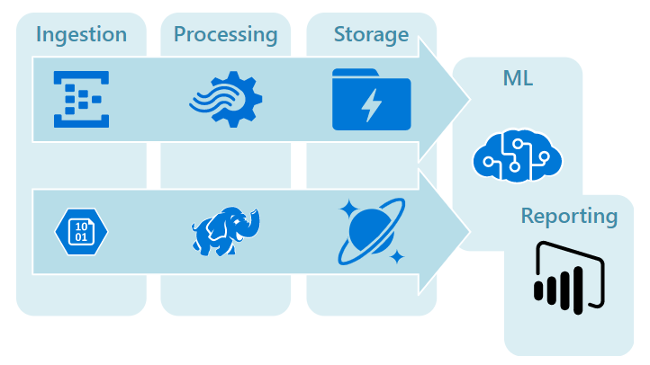
Big Data Solutions
Notes:
Big data solutions. A big data architecture is designed to handle the ingestion, processing, and analysis of data that is too large or complex for traditional database systems. The data may be processed in batch or in real time. Big data solutions typically involve a large amount of non-relational data, such as key-value data, JSON documents, or time series data. Often traditional RDBMS systems are not well-suited to store this type of data. The term NoSQL refers to a family of databases designed to hold non-relational data. The term isn't quite accurate, because many non-relational data stores support SQL compatible queries. The term NoSQL stands for "Not only SQL".

Slide 28
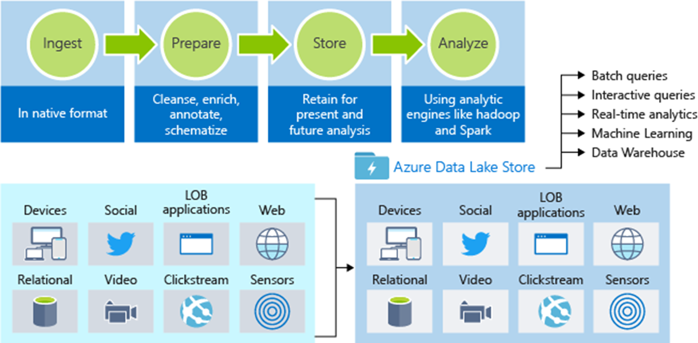
Big Data Solutions
Notes:
Structured and unstructured data
Hyperscale repository for big data analytic workloads
No limits on account sizes, file sizes, or the amount of data
Hadoop accessed (available through HDInsight) using WebHDFS-compatible REST APIs
Data Lake is a large repository that stores both structured and unstructured data.
An enterprise-wide hyperscale repository for big data analytic workloads.
Does not impose limits on account sizes, file sizes, or the amount of data that can be stored.
Can be accessed from Hadoop (available through HDInsight) using the WebHDFS-compatible REST APIs.

Slide 29
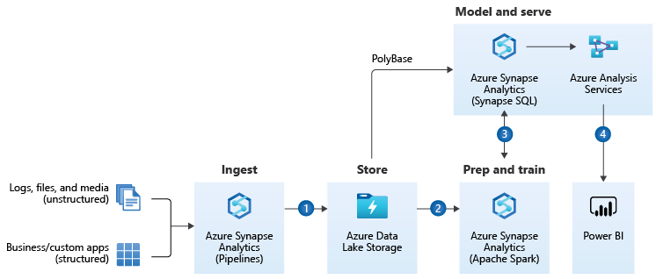
Enterprise Data Warehouse Architecture
Notes:
An enterprise data warehouse lets you bring together all your data at any scale easily, and to get insights through analytical dashboards, operational reports, or advanced analytics for all your users.
Combine all your structured, unstructured and semi-structured data (logs, files, and media) using Azure Synapse Analytics Pipelines to Azure Blob Storage.
Leverage data in Azure Blob Storage to perform scalable analytics with Azure Synapse Analytics Spark pool and achieve cleansed and transformed data.
Cleansed and transformed data can be combined with existing structured data, creating one hub for all your data with Azure Synapse Analytics.
Build operational reports and analytical dashboards on top of dedicated SQL pool to derive insights from the data, and use Azure Analysis Services to serve thousands of end users.
Azure Synapse Analytics is the fast, flexible, and trusted cloud data warehouse that lets you scale, compute, and store elastically and independently, with a massively parallel processing architecture.
Synapse Pipelines Documentation allows you to create, schedule and orchestrate your ETL/ELT workflows.
Azure Blob storage is a Massively scalable object storage for any type of unstructured data-images, videos, audio, documents, and more-easily and cost-effectively.
Azure Synapse Analytics Spark pools is a parallel processing framework that supports in-memory processing to boost the performance of big-data analytic applications.
Azure Analysis Services is an enterprise grade analytics as a service that lets you govern, deploy, test, and deliver your BI solution with confidence.
Power BI is a suite of business analytics tools that deliver insights throughout your organization. Connect to hundreds of data sources, simplify data prep, and drive ad hoc analysis. Produce beautiful reports, then publish them for your organization to consume on the web and across mobile devices.

Slide 30
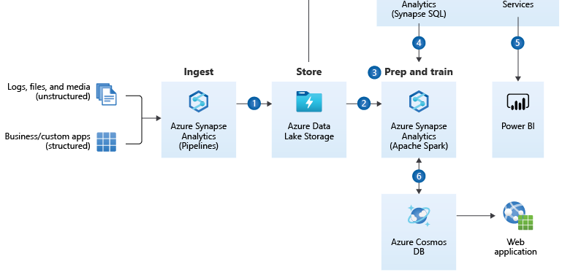
Advanced Analytics Architecture
Notes:
Transform your data into actionable insights using the best-in-class machine learning tools. This architecture allows you to combine any data at any scale, and to build and deploy custom machine learning models at scale.
Bring together all your structured, unstructured and semi-structured data (logs, files, and media) using Synapse Pipelines to Azure Data Lake Storage.
Use Apache Spark pools to clean and transform the structureless datasets and combine them with structured data from operational databases or data warehouses.
Use scalable machine learning/deep learning techniques, to derive deeper insights from this data using Python, Scala or .NET, with notebook experiences in Apache Spark pool.
Leverage Apache Spark pool and Synapse Pipelines in Azure Synapse Analytics to access and move data at scale.
Query and report on data in Power BI.
Take the insights from Apache Spark pools to Cosmos DB to make them accessible through web and mobile apps.

Slide 31
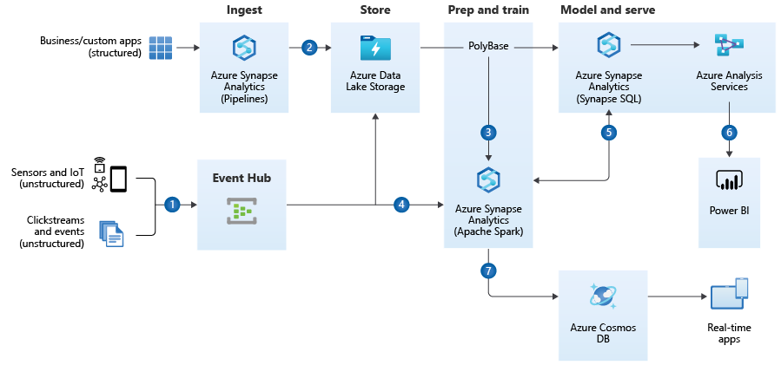
Real Time Analytics on Big Data Architecture
Notes:
Get insights from live streaming data with ease. Capture data continuously from any IoT device, or logs from website clickstreams, and process it in near-real time.
Easily ingest live streaming data for an application using Azure Event Hubs.
Bring together all your structured data using Synapse Pipelines to Azure Blob Storage.
Take advantage of Apache Spark pools to clean, transform, and analyze the streaming data, and combine it with structured data from operational databases or data warehouses.
Use scalable machine learning/deep learning techniques, to derive deeper insights from this data, using Python, Scala, or .NET, with notebook experiences in Apache Spark pools.
Leverage Apache Spark pool and Synapse Pipelines in Azure Synapse Analytics to access and move data at scale.
Build analytics dashboards and embedded reports in dedicated SQL pool to share insights within your organization and use Azure Analysis Services to serve this data to thousands of users.
Take the insights from Apache Spark pools to Cosmos DB to make them accessible through real time apps.

Slide 32
Design for Messaging

Slide 33
Design for Messaging
The distributed nature of cloud applications requires a messaging infrastructure that connects the components and services, ideally in a loosely coupled manner in order to maximize scalability.
Asynchronous messaging is widely used, and provides many benefits, but also brings challenges such as the ordering of messages, poison message management, idempotency, and more.

Slide 34
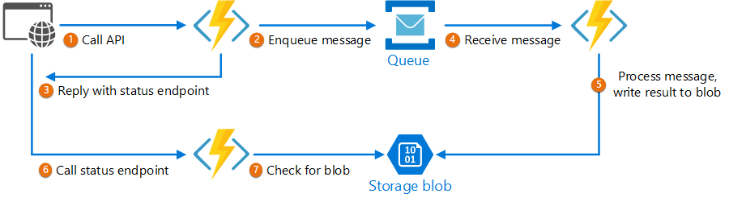
Asynchronous Request-Reply pattern
Decouple backend processing from a frontend host, where backend processing needs to be asynchronous, but the frontend still needs a clear response.

Slide 35
Design for Messaging
Claim Check | Split a large message into a claim check and a payload to avoid overwhelming a message bus.
Choreography | Have each component of the system participate in the decision-making process about the workflow of a business transaction, instead of relying on a central point of control.
Competing Consumers | Enable multiple concurrent consumers to process messages received on the same messaging channel.
Pipes and Filters | Break down a task that performs complex processing into a series of separate elements that can be reused.
Priority Queue | Prioritize requests sent to services so that requests with a higher priority are received and processed more quickly than those with a lower priority.
Publisher-Subscriber | Enable an application to announce events to multiple interested consumers asynchronously, without coupling the senders to the receivers.
Queue-Based Load Leveling | Use a queue that acts as a buffer between a task and a service that it invokes in order to smooth intermittent heavy loads.
Scheduler Agent Supervisor | Coordinate a set of actions across a distributed set of services and other remote resources.
Sequential Convoy | Process a set of related messages in a defined order, without blocking processing of other groups of messages.

Slide 36
Design for Management and Monitoring

Slide 37
Design for Management and Monitoring
Application-centric platform monitoring, encompassing both hot and cold telemetry paths for metrics and logs, respectively:
Operating system metrics; for example, performance counters and custom metrics;
Operating system logs; for example, Internet Information Services, Event Tracing for Windows, and syslog;
Resource health events;

Slide 38
Design for Management and Monitoring
Security audit logging and achieving a horizontal security lens across your organization's entire Azure estate:
Potential integration with on-premises security information and event management (SIEM) systems such as ServiceNow, ArcSight, or the Onapsis security platform;
Azure activity logs;
Azure Active Directory (Azure AD) audit reports;
Azure diagnostic services, logs, and metrics; Azure Key Vault audit events; network security group (NSG) flow logs; and event logs;
Azure Monitor, Azure Network Watcher, Azure Security Center and Azure Sentinel;

Slide 39
Built-in Security Monitoring

Slide 40
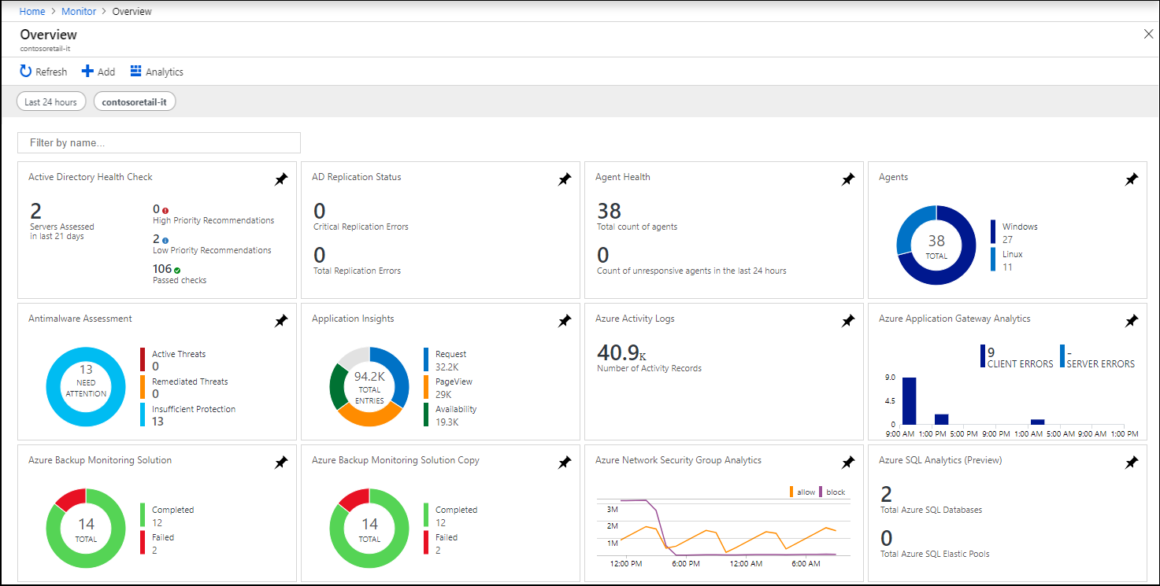
Monitoring Solutions
Notes:
Monitoring solutions can contain multiple types of Azure resources, and you can view any resources included with a solution just like any other resource. For example, any log queries included in the solution are listed under Solution Queries in Query explorer. You can use those queries when performing ad hoc analysis with log queries.

Slide 41
Design for Security

Slide 42
Design for Security
Microsoft Azure provides confidentiality, integrity, and availability of customer data, while also enabling transparent accountability.
Notes:
One of the best reasons to use Azure for your applications and services is to take advantage of its wide array of security tools and capabilities. These tools and capabilities help make it possible to create secure solutions on the secure Azure platform. Microsoft Azure provides confidentiality, integrity, and availability of customer data, while also enabling transparent accountability.

Slide 43
Design for Security
Align Security Priorities to Mission
Security resources are almost always limited, so prioritize efforts and assurances by aligning security strategy and technical controls to the business using classification of data and systems.
Security resources should be focused first on people and assets (systems, data, accounts, etc.) with intrinsic business value and those with administrative privileges over business critical assets.

Slide 44
Design for Security
Build a Comprehensive Strategy
A security strategy should consider investments in culture, processes, and security controls across all system components.
The strategy should also consider security for the full lifecycle of system components including the supply chain of software, hardware, and services.

Slide 45
Design for Security
Drive Simplicity
Complexity in systems leads to increased human confusion, errors, automation failures, and difficulty of recovering from an issue.
Favour simple and consistent architectures and implementations.

Slide 46
Design for Security
Design for Attackers
Your security design and prioritization should be focused on the way attackers see your environment, which is often not the way IT and application teams see it.
Inform your security design and test it with penetration testing to simulate one-time attacks.
Use red teams to simulate long-term persistent attack groups.

Slide 47
Design for Security
Leverage Native Controls
Favour native security controls built into cloud services over external controls from third parties.
Native security controls are maintained and supported by the service provider, eliminating or reducing effort required to integrate external security tooling and update those integrations over time.

Slide 48
Design for Security
Use Identity as Primary Access Control
Access to resources in cloud architectures is primarily governed by identity-based authentication and authorization for access controls.
Your account control strategy should rely on identity systems for controlling access rather than relying on network controls or direct use of cryptographic keys.

Slide 49
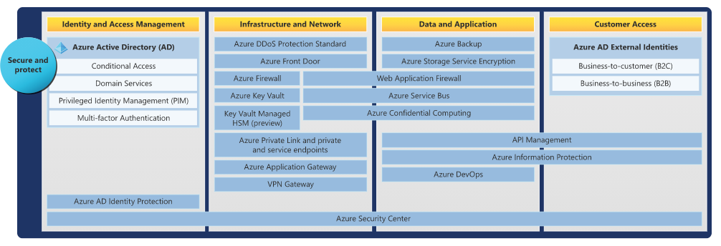
Azure Tools: Secure And Protect
Notes:
https://docs.microsoft.com/en-us/azure/security/fundamentals/end-to-end

Slide 50
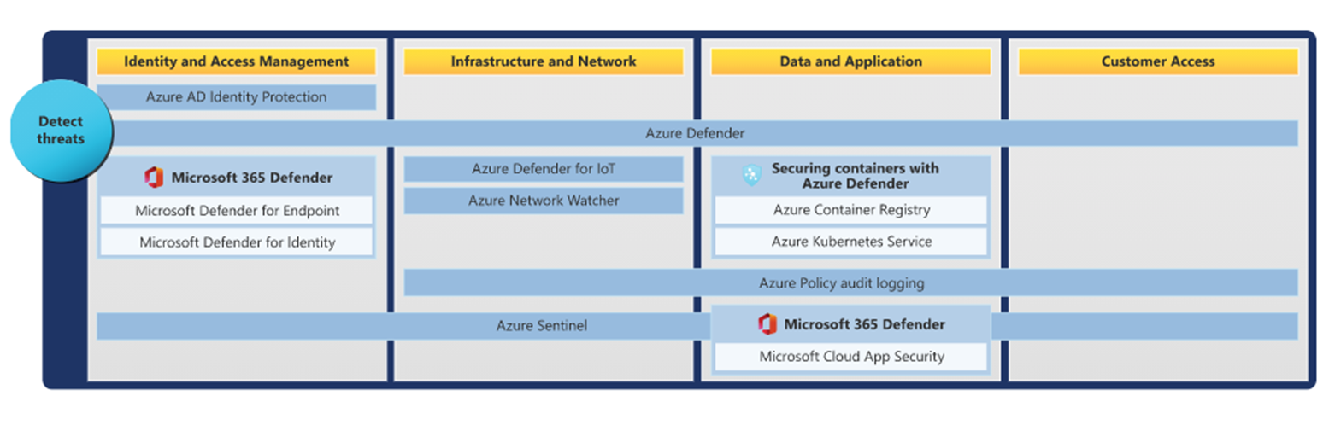
Azure Tools: Detect Threats
Notes:
https://docs.microsoft.com/en-us/azure/security/fundamentals/end-to-end

Slide 51
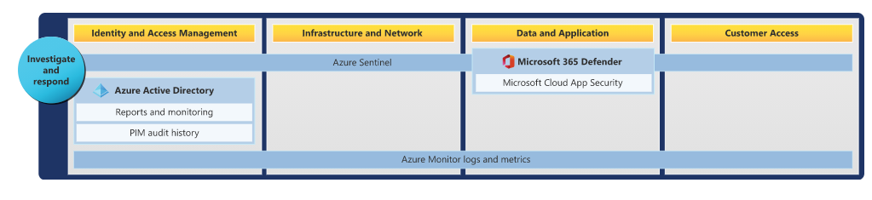
Azure Tools: Investigate And Respond
Notes:
https://docs.microsoft.com/en-us/azure/security/fundamentals/end-to-end

Slide 52
Case Studies

Slide 53
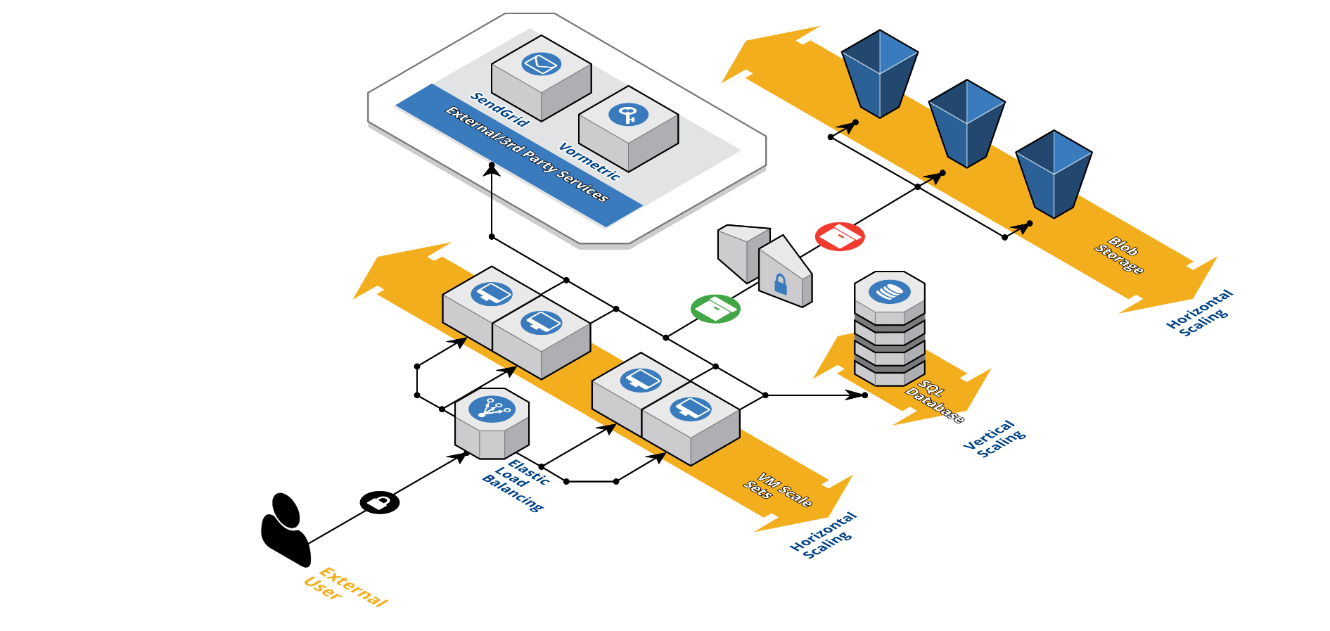
Enterprise File Transfer

Slide 54
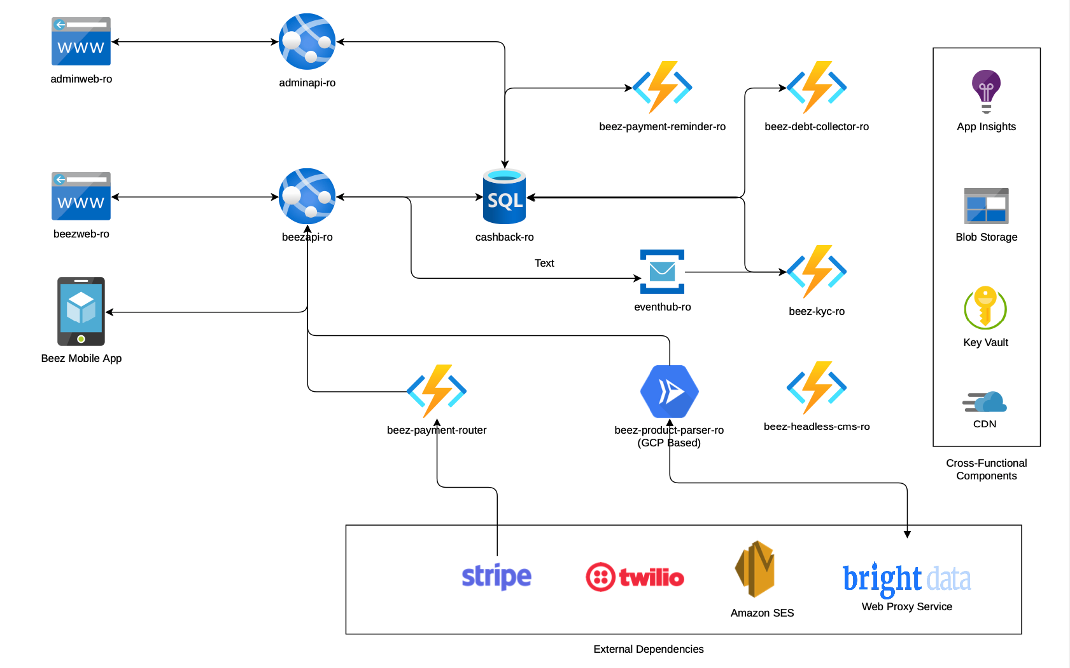
Fintech Software

Slide 55
Personal Finance Management Software

Slide 56
Thank You! Open Discussion & Questions

Slide 57
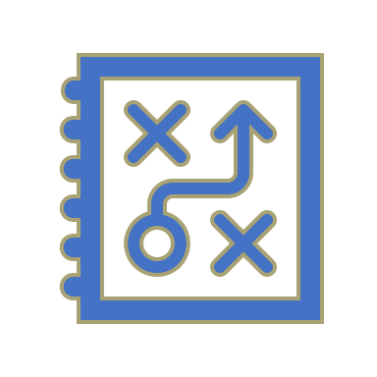
Design Challenge

